Slide 1

CAP 6317/4773: Social Media Mining
Lecture 21: Recommendation Engines
Raiyan Abdul Baten, Ph.D.
April 4, 2024

Slide 2
Recap

Slide 3
Potential Choices of an Instrument Variable
Policy changes
Weather events
Natural disasters

Slide 4
Does Smoking CAUSE poor health?
Depression
Tobacco tax
Poor health
Smoking
“Instrument variable”: Exogenous variable!
Endogenous variables

Slide 5
Use Weather as an Instrument
Apple watch introduces a cool feature
Weather at my friend’s location
I run
My friend runs
Aral, Sinan, and Christos Nicolaides. "Exercise contagion in a global social network." Nature Communications 8.1 (2017): 14753.

Slide 6
Use Recommendation Engine Updates as an Instrument
Job market situation changes
Peer recommendation engine updates
My ‘weak tie’ friend works at Google
I join Google
LinkedIn kept recommending me Google opportunities
Rajkumar, Karthik, et al. "A causal test of the strength of weak ties." Science 377.6612 (2022): 1304-1310.

Slide 7
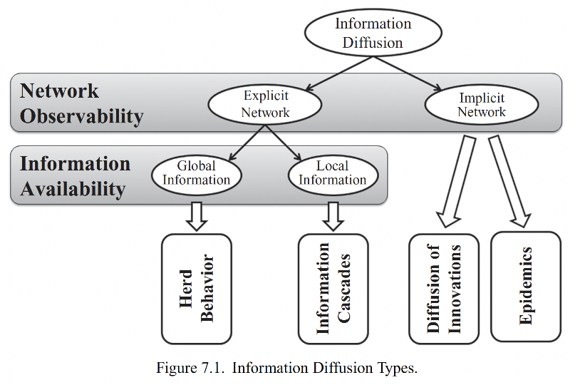

Slide 8
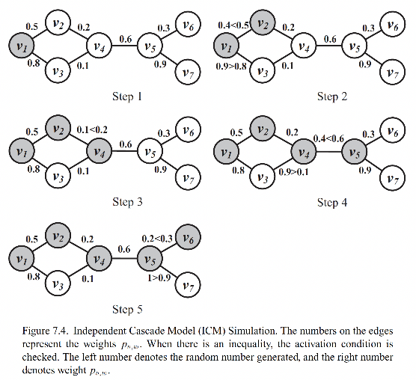

Slide 9
‘Network’ Interventions for Maximizing the Spread of Cascades
Increase the number of out-links of the sender node
Increase the number of in-links of receiver nodes
Increase the activation probability of a node (p_{v,w})

Slide 10
‘Network’ Interventions for Minimizing the Spread of Cascades
Limit the number of out-links of the sender node
Limit the number of in-links of receiver nodes
Decreasing the activation probability of a node (p_{v,w})
Looking at only the network elements using this model, it appears that tuning these three parameters is all we need for designing a successful intervention. But we must consider the human elements working on top of the network elements, since all of these parameters are determined by socio-psychological factors

Slide 11
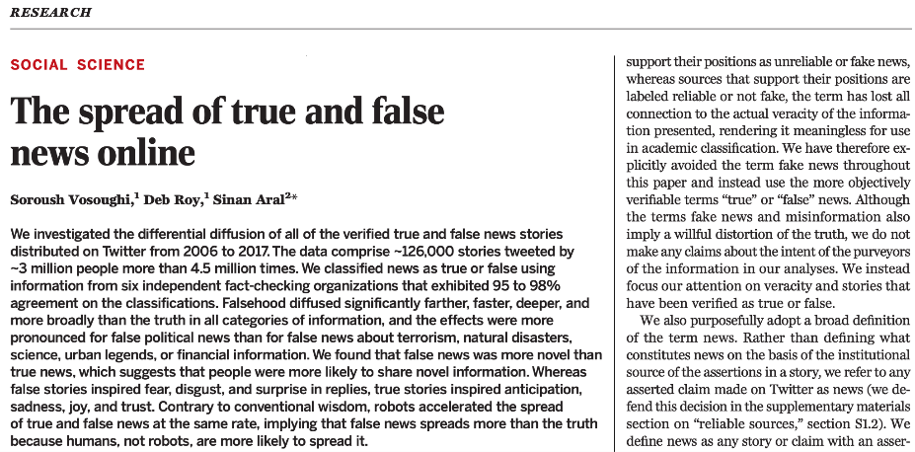

Slide 12
The ‘Human’ Element in Information Diffusion
False news is more novel than true news
People are more likely to share novel information
False stories inspire fear, disgust, and surprise in replies
True stories inspired anticipation, sadness, joy, and trust
False news spreads more than the truth because humans, not robots, are more likely to spread it

Slide 13
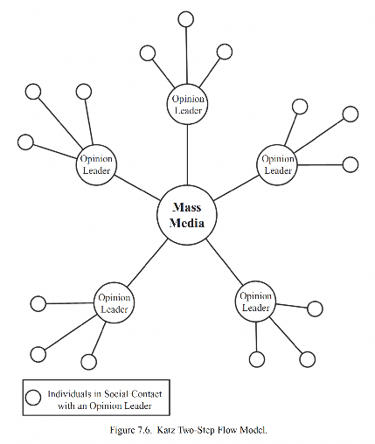

If the opinion leaders have both the network and human elements we discussed, they will be more successful in diffusing information

Slide 14
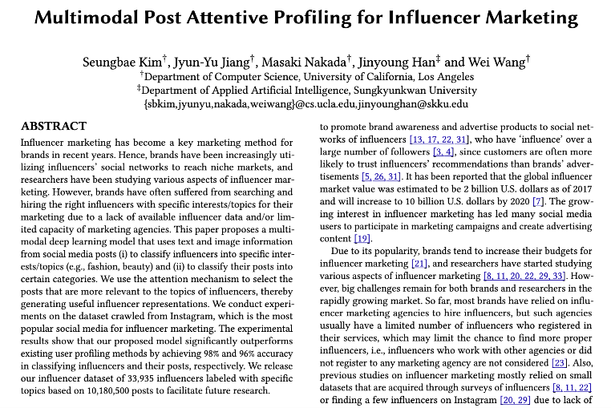

Slide 15
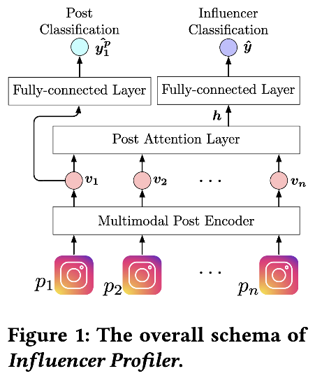

Slide 16
Social Science
Network/computational Science
Social Media Mining
Statistics and Data Mining

Slide 17
Essentials
Communities and Interactions
Applications
Graph essentials
Network measures
Network models
Community detection
Information diffusion
Social Influence
Recommendation engines
Behavior analysis
Who are the most important people in the network?
How do people befriend others?
How can we find interesting patterns in user-generated content?
How can we identify communities in a social network?
How far can an article be transmitted in a social network?
How can we measure the influence of individuals in a social network?
How can we recommend content or friends to individuals online?

Slide 18
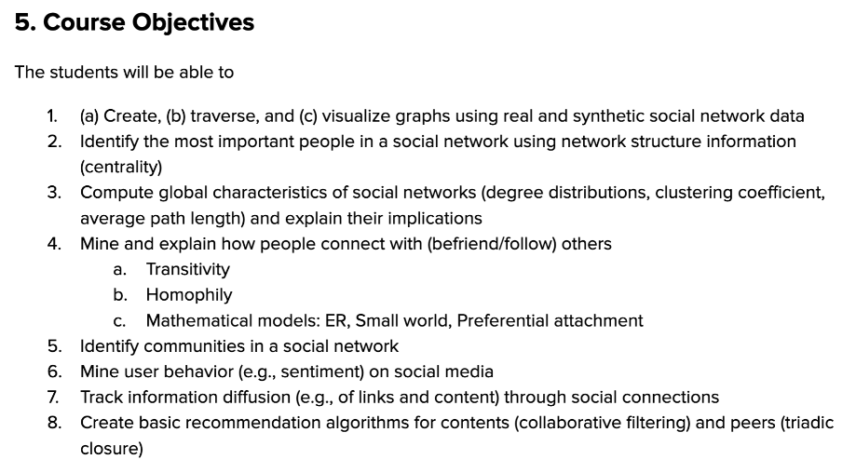

Slide 19
Reminder to self: Attendance

Slide 20
User Modeling and Recommendation Engines

Slide 21
Recommendation vs Search
The key is personalization
“Best 2024 movie to watch” should give user-tailored results in a Recommendation setting
We’re trying to guess what you might like in the future

Slide 22
Challenges
Cold start
A new user has no data at all – how do you even generate a recommendation?

Slide 23
Challenges
Cold start
A new user has no data at all – how do you even generate a recommendation?
Data Sparsity
At a system level, what if only a few individuals rate many items while many other individuals rate only a few items?

Slide 24
Challenges
Cold start
A new user has no data at all – how do you even generate a recommendation?
Data Sparsity
At a system level, what if only a few individuals rate many items while many other individuals rate only a few items?
Attacks
Fake accounts can push the ratings up/down

Slide 25
Challenges
Privacy
Did the user give their informed consent on private data usage?

Slide 26
Challenges
Privacy
Did the user give their informed consent on private data usage?
Explanation
Why did the system make this recommendation?

Slide 27
Person Recommendation
Social platforms are dead without users → More users, more valuation!
Monthly active users worldwide as of December 2022:
X/Twitter: 368 million
Facebook: 3 billion
Rule of thumb: People will stay if they can ‘hangout’ with their friends there!
Notes:
95.
11.66920345

Slide 28
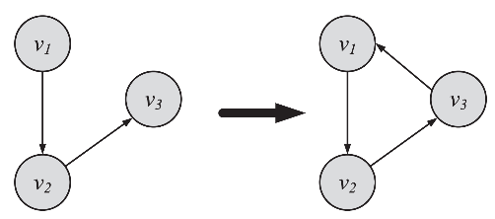
Person Recommendation
Network characteristics are natural choices for making peer recommendations
Transitive Linking: Triadic closure
Close the triangles: Recommend peers with high mutual friend counts

Slide 29
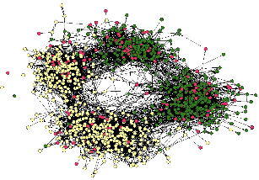
Person Recommendation
Network characteristics are natural choices for making peer recommendations
Assortativity
Now we’re considering node attributes on top of the network structure
Pick the assortativity dimension you care about: Demographic attributes (Facebook)? Career attributes (Linkedin)? Interest attributes (Reddit, Pinterest)?
Recommend peers so that assortativity increases/decreases along the desired dimension

Slide 30
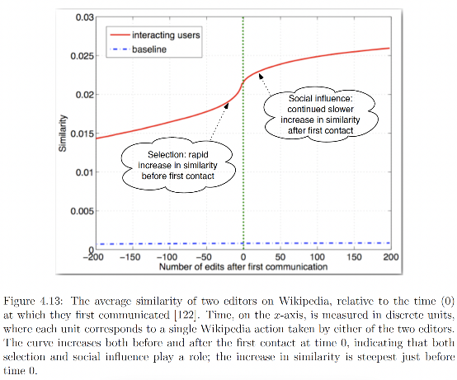
The pairwise similarity between Wikipedia editors increases steeply just before they interact for the first time. Put this insight to use: Recommend two people to befriend each other if their similarity has been steeply increasing recently. You’ll need longitudinal data for inferring this.
Crandall, David, et al. "Feedback effects between similarity and social influence in online communities." Proceedings of the 14th ACM SIGKDD international conference on Knowledge discovery and data mining. 2008.

Slide 31
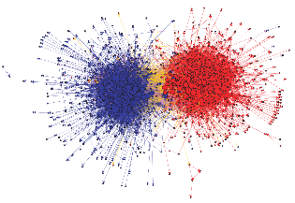
Person Recommendation
Network characteristics are natural choices for making peer recommendations
Community Detection
Find and recommend others in the same community
“Oh I see you’re a football fan, here’s another football fan you can befriend”
Slippery slope: can lead to polarization and extremity
Echo chambers from like-minded people can fuel confirmation bias

Slide 32
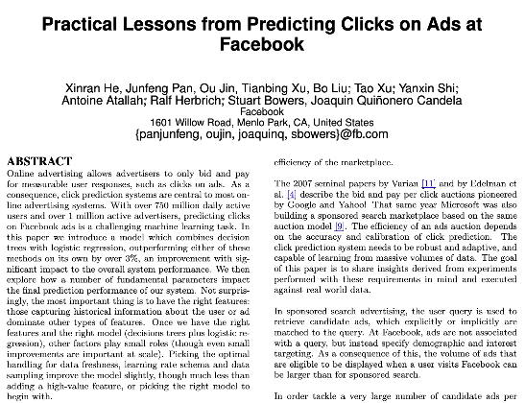
Content Recommendation
Good peer recommendation sustains your platform, good content recommendation makes you money
Optimizing Click-through Rates (CTR) is the money-making no-brainer

Slide 33
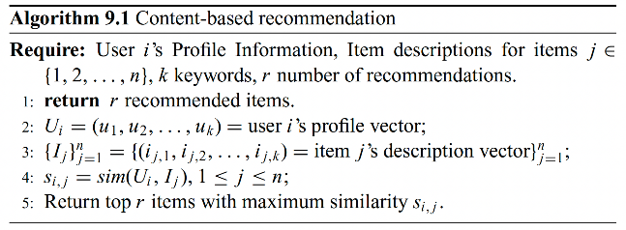
Simple Idea: Cosine Similarity
Represent each user i using an embedding vector, u_{i}
Represent each content j using an embedding vector, c_{j}
Loop over j: Take cosine similarity for every user-content pair: cosine(u_{i}, c_{j})
Return top r contents with the highest similarity to recommend to u_{i}

Slide 34
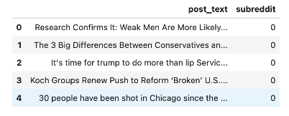
How do you learn the Embedding Vectors?
In Coding Assignment 4, you created a 500-dimension embedding vector for each Reddit post. The state-of-the-art method will be to use transformer models to generate the embeddings.

Slide 35
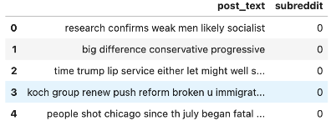
How do you learn the Embedding Vectors?
We first cleaned up the original Reddit posts

Slide 36
How do you learn the Embedding Vectors?
We then took TF-IDF vector representation of each post. The first step is to create a ‘count’ vector: if there are 5000 unique words in the corpus, each post will have a 5000 dimension vector, where the w-th entry will simply be the count of the w-th word in the given post.

Slide 37
How do you learn the Embedding Vectors?
We then penalized words that occur in many posts, so that only the salient words in each post have high weights

Slide 38
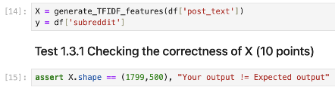
How do you learn the Embedding Vectors?
In the end, we kept 500 dimension vectors (capturing the most prominent 500 words in the corpus) to represent the posts

Slide 39
How do you learn the Embedding Vectors?
Represent each user using an embedding vector, u_{i}
Represent each content using an embedding vector, c_{j}
Take cosine similarity for every user-content pair: cosine(u_{i}, c_{j})
Return top r items with the highest similarity
If you know textual descriptions of the user’s profile (e.g., LinkedIn profile) and the content (e.g., LinkedIn job posting), you can convert the text descriptions into vectors using NLP, and compute cosine similarities of the vectors to make recommendations

Slide 40
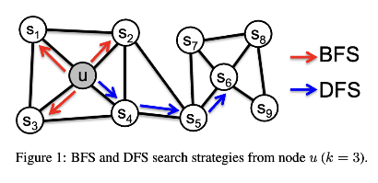

How do you learn the Embedding Vectors?
If you know the social network of users, (or the bipartite network of users and contents), you can generate embedding vectors for each user/content using graph embedding techniques. The Node2Vec method is popular and easy; there are Graph Neural Methods that perform even better

Slide 41
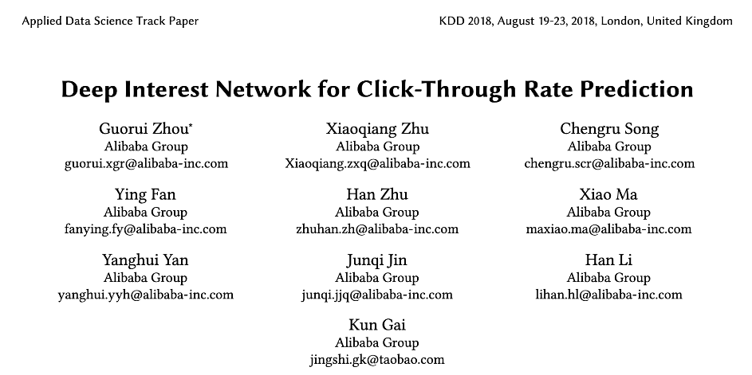
Paper from Alibaba: Let’s try to predict whether a user will click on a content recommendation

Slide 42
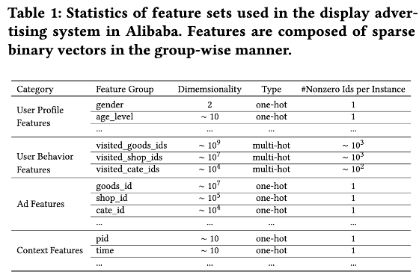
Notice the set of features: We have features on the user’s demographic info, in-app behavior, ad’s info, and context factors.

Slide 43
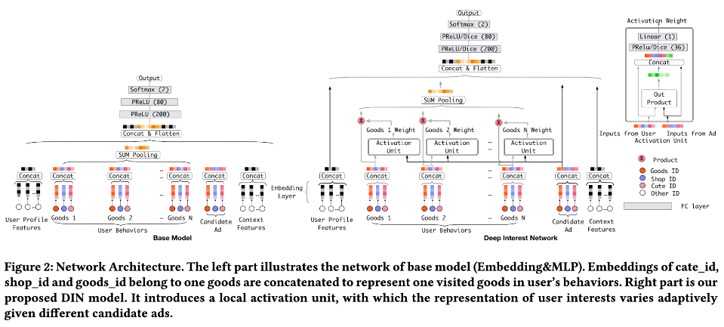
Using all of those features, let us train an end-to-end model that will predict Click Through Rate

Slide 44
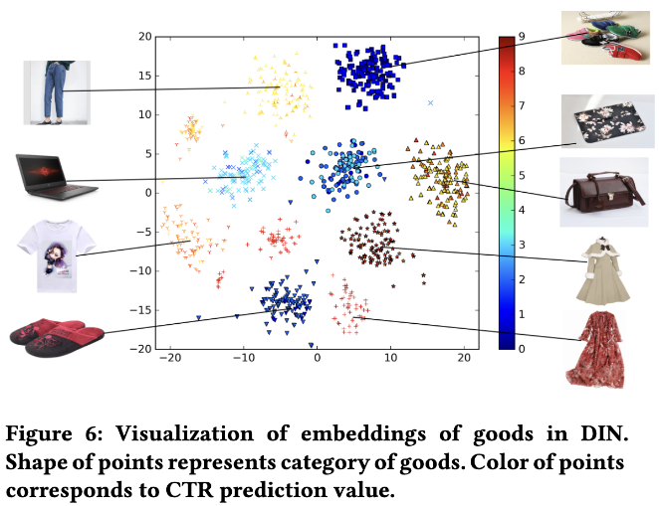
Embedding vectors learned by the model. Clearly, the embedding vectors are meaningful since similar products are clustered together in the vector space. Interestingly, if we predict click through rates using these embedding vectors, we find that click-through rates are more predictable for dresses than shoes!!

Slide 45
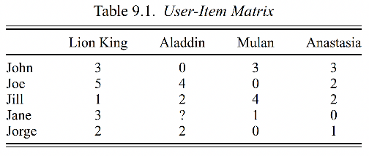
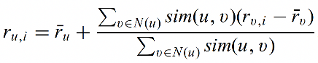
Collaborative Filtering

Slide 46
Collaborative Filtering
We want predict what rating Jane (u) is likely to give the movie Aladdin (i). Recommend movies to Jane with the highest predicted ratings

Slide 47
Collaborative Filtering
People may have their own ‘standards’ when rating movies. Some people just give higher ratings than others. This term captures Jane’s average ratings of other movies, giving us a baseline prediction. From here, we want to add or subtract ratings based on how likely she is to like or dislike Aladdin.

Slide 48
Collaborative Filtering
N(u) is a set of users most similar to Jane. Let’s sum over the similar users’ tendency to like or dislike Aladdin, weighted by how similar the users are to Jane

Slide 49
Collaborative Filtering
This term captures how much the user v (one of the most similar users to Jane) liked or disliked Aladdin compared to v’s own average rating

Slide 50
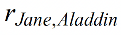
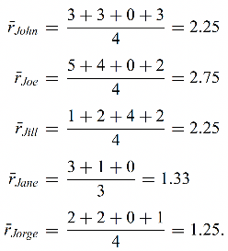
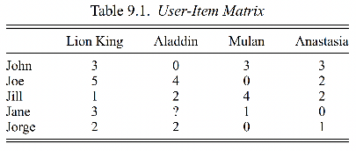
Collaborative Filtering
Find

Slide 51
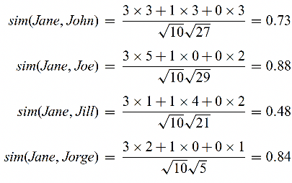
Collaborative Filtering
Find

Slide 52
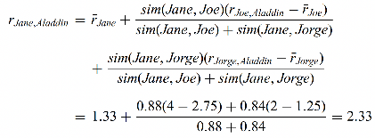
Collaborative Filtering
Find

Slide 53
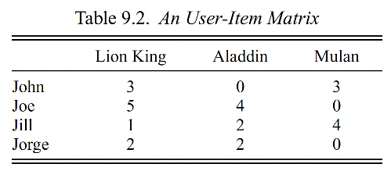
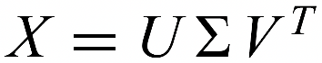
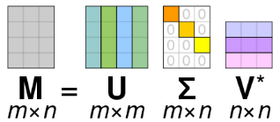
Collaborative Filtering using Singular Value Decomposition (SVD)
The user-item matrix can be extremely large and sparse. Let us find a reduced-sized approximation of the matrix so that we only keep the ‘systematic’ patterns of user-item interaction and get rid of the noise. SVD allows us to achieve that. Using SVD, the user-item matrix is first decomposed into three matrices in a lossless manner (no information is lost yet).

Slide 54
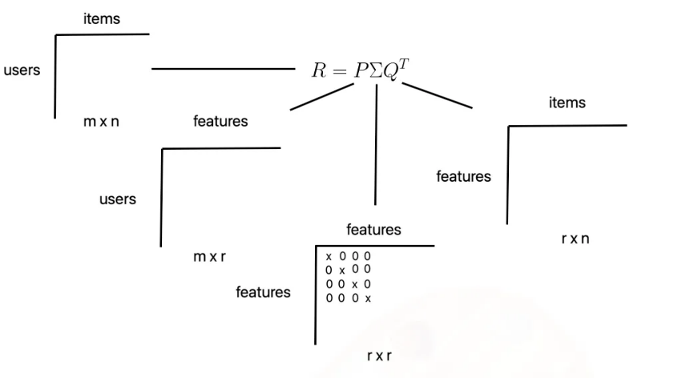
This is our original user-item matrix. We have m users and n items
Stolen from https://medium.com/@corymaklin/model-based-collaborative-filtering-svd-19859c764cee

Slide 55
The first decomposed matrix captures latent representations of the rows (users). The SVD operation will actually generate an mxm matrix, but we will crop the matrix to keep the first r columns (we are losing information now). Each of the m users will then be represented with a r dimensional feature vector in this truncated matrix
Stolen from https://medium.com/@corymaklin/model-based-collaborative-filtering-svd-19859c764cee

Slide 56
The last decomposed matrix captures latent representations of the columns (items). Once again, the SVD operation will create an nxn matrix, but we will crop the matrix to keep the first r rows. Each of the n items will then be represented with a r dimensional feature vector (along the columns) in this matrix
Stolen from https://medium.com/@corymaklin/model-based-collaborative-filtering-svd-19859c764cee

Slide 57
The absolute values in the diagonal matrix Sigma represent how important the associated dimensions are in terms of expressing the original ratings matrix.
Stolen from https://medium.com/@corymaklin/model-based-collaborative-filtering-svd-19859c764cee

Slide 58
If we sort those values in descending order and exclude all but the top r (user defined) features, we can obtain the best approximation of the user-item matrix by multiplying the truncated matrices back together.
Stolen from https://medium.com/@corymaklin/model-based-collaborative-filtering-svd-19859c764cee

Slide 59
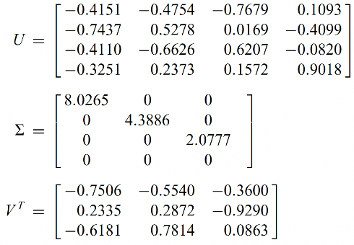
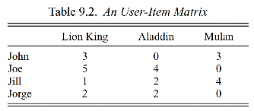
Collaborative Filtering using SVD

Slide 60
Collaborative Filtering using SVD
Original decomposed matrix before truncation. Each of the 4 users has their feature representation along the rows of U

Slide 61
Collaborative Filtering using SVD
Similarly, each of the 3 movies has their untruncated feature representation along the columns of V^{T}

Slide 62
Collaborative Filtering using SVD
Notice how the diagonal values are sorted in a descending order. The absolutes values here denote the importance of each feature dimension. We would like to keep only the most important dimensions

Slide 63
Collaborative Filtering using SVD
Let’s truncate the matrices so that we retain the best two dimensions, i.e., choose r=2. Here, r is the number of latent features we choose. If r is too small, we will lose too much information. If r is too high, we’ll be back to the original sparsity problem
Notes:
Low-rank approximations of matrices remove noise by assuming that the matrix is not generated at random and has an underlying structure.
SVD can help remove noise by computing a low-rank approximation of a matrix

Slide 64
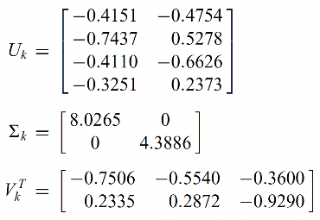
Collaborative Filtering using SVD
Truncated matrices. Multiplying them back together will give us a lower-rank approximation of the original user-item matrix. Running the collaborative filtering algorithm on this reduced matrix will make prediction-generation a lot easier.

Slide 65
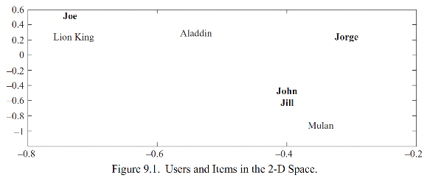
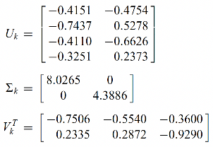
Notice how the first row in truncated U denotes John’s representation in the 2D space (since r=2). Just eyeballing this plot, we know that John is the most similar user to Jill!

Slide 66
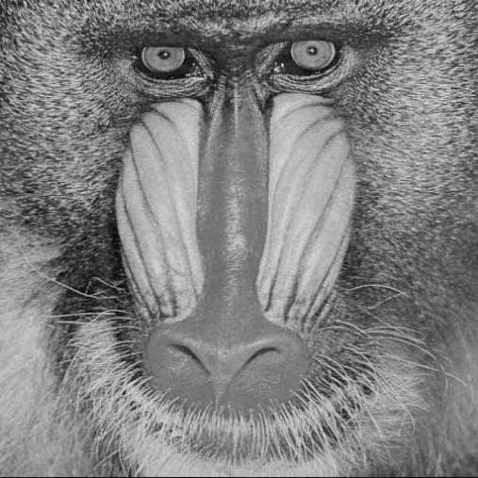
Using SVD, a 512 x 512 image (where the matrix entries represent pixel brightness) can be decomposed into superpositions of 512 single images of horizontal and vertical stripes
Stolen from https://stats.stackexchange.com/questions/177102/what-is-the-intuition-behind-svd
Notes:
https://stats.stackexchange.com/questions/177102/what-is-the-intuition-behind-svd

Slide 67

Rank-1 approximation of the original image (i.e., decomposed, truncated using r=1, and multiplied back together). Since we’ve only kept 1-dimensional features, we’ve lost too much information and cannot recreate the original matrix reasonably by multiplying back the decomposed and truncated (with r=1) matrices. Still, you can sense the darker and brighter parts of the original image being retained in this approximation!
Notes:
https://stats.stackexchange.com/questions/177102/what-is-the-intuition-behind-svd

Slide 68
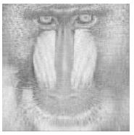
Rank-20 approximation of the original image (i.e., decomposed, truncated using r=20, and multiplied back together). Now we’ve lost less information and can visually see an approximation the original image
Notes:
https://stats.stackexchange.com/questions/177102/what-is-the-intuition-behind-svd

Slide 69
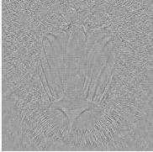
Residual image after the rank-20 approximation (i.e., the part not captured by the lower rank approximation). You can see that areas that are difficult to represent as superposition of vertical/horizontal lines (e.g., around the eyes and nose) have lost the most information. We’re essentially treating the complex parts of the image as noise and only capturing the systematic patterns in the row-column interactions of the original matrix.
Notes:
https://stats.stackexchange.com/questions/177102/what-is-the-intuition-behind-svd

Slide 70
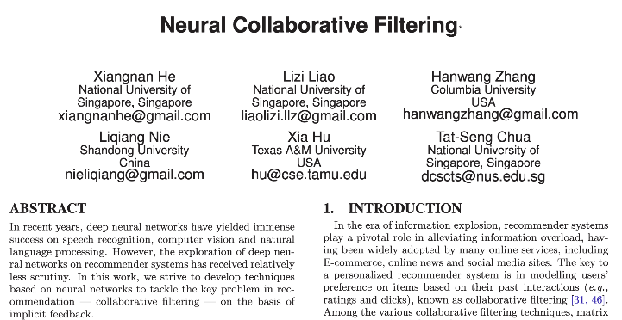

Slide 71
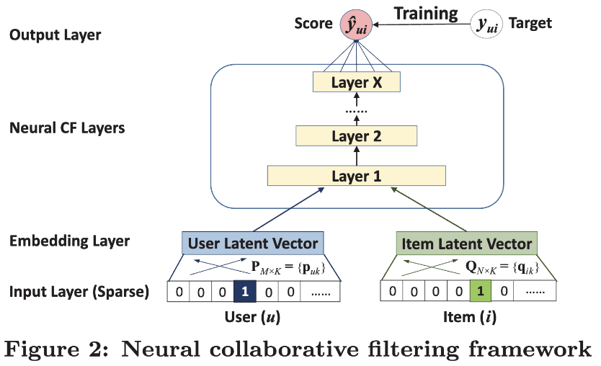

Slide 72
References
Chapter 9 of the textbook
What is the intuition behind SVD?
“Model Based Collaborative Filtering — SVD” by Cory Maklin

Slide 73
Summary

